Slide 1
ENTREPRENEURIAL SKILLS
DR. BHUPINDER KAUR

Slide 2
ABOUT THE COURSE:-
1.
Multi-Disciplinary
2.
2 credits
3.
30 Hours

Slide 3
WHAT DO YOU MEAN BY ENTREPRENEUR?

Slide 4


Slide 5
EVOLUTION OF THE WORD “ENTREPRENEUR”
The word ‘entrepreneur’ is derived from French word ‘Entrependre’ which means undertaking the risk of enterprise and further it was used to designate an organizer of musical or other entertainments.
Later in 16th century it was used for army leaders. It was extended to cover civil engineering activities such as construction in 17th century.
But it was Richard Cantillon, an Irishman living in France who first used the term entrepreneur to refer to economic activities. According to Cantillon “An entrepreneur is a person who buys factor services at certain prices with a view to selling its product at uncertain prices”.

Slide 6
WHO IS AN ENTREPRENEUR
Creates something new
Searches new opportunities
Unites factors of production
Innovation
Skill and Far sightedness
Takes risks
EARNS PROFIT

Slide 7
DEFINITION OF ENTREPRENEUR
According to F.A. Walker : “Entrepreneur is one who is endowed with more than average capacities in the task of organizing and coordinating the factors of production, i.e. land, labour capital and enterprises”.
According to E.E. Hagen : “An entrepreneur is an economic man who tries to maximize his profits by innovation, involve problem solving and gets satisfaction from using his capabilities on attacking problems”.
International Labour Organization (ILO) defines “entrepreneurs as those people who have the ability to see and evaluate business opportunities, together with the necessary resources to take advantage of them and to initiate appropriate action to ensure success”

Slide 8
There are various views about entrepreneur which are broadly classified into three groups:-
Risk Bearer
1
Organizer
2
Innovator
3

Slide 9
Functions of entrepreneur
Idea Generation : The first and the most important function of an Entrepreneur is idea generation. Idea generation implies product selection and project identification. Idea generation is possible through vision, insight, keen observation, education, experience and exposure. This needs scanning of business environment and market survey.
Determination of Business Objectives : Entrepreneur has to state and lay down the business objectives. Objectives should be spelt out in clear terms. The entrepreneur must be clear about the nature and type of business, i.e. whether manufacturing concern or service oriented unit or a trading business so that he can very well carry on the venture in accordance with the objectives determined by him.
Raising of Funds : All the activities of the business depend upon the finance and hence fund raising is an important function of an entrepreneur. An entrepreneur can raise the fund from internal source as well as external source. He should be aware of different sources of funds. He should also have complete knowledge of government sponsored schemes in which he can get government assistance in the form of seed capital, fixed and working capital for his business.

Slide 10
Procurement of Machines and Materials : Another important function of an entrepreneur is to procure raw materials and machines. Entrepreneur has to identify cheap and regular sources of raw materials which will help him to reduce the cost of production and face competition boldly. While procuring machineries, he should specify the technical details and the capacity. He should consider the warranty, after sales service facilities etc. before procuring machineries.
Market Research : Market research is the systematic collection of data regarding the product which the Entrepreneur wants to manufacture. Entrepreneur has to undertake market research persistently to know the details of the intending product, i.e. the demand for the product, size of the market/customers, the supply of the product, competition, the price of the product etc.
Determining form of Enterprise : Entrepreneur has to determine form of enterprise depending upon the nature of the product, volume of investment etc. The forms of ownership are also proprietorship, partnership, Joint Stock Company, co-operative society etc. Determination of ownership right is essential on the part of the entrepreneur to acquire legal title to assets.
Recruitment of Manpower : To carry out this function, an entrepreneur has to perform the following activities. a. Estimate man power requirement for short term and long term b. Laying down the selection procedure. c. Designing scheme of compensation. d. Laying down the service rules. e. Designing mechanism for training and development.
Implementation of the Project : Entrepreneur has to develop schedule and action plan for the implementation of the project. The project must be implemented in a time bound manner. All the activities from the conception stage to the commissioning stage are to be accomplished by him in accordance with the implementation schedule to avoid cost and time over run. He has to organize various resources and coordinate various activities. This implementation of the project is an important function of the entrepreneur. All the above functions of the entrepreneur can precisely be put into three categories of innovation, risk bearing, and organizing and managing functions.

Slide 11

TYPES OF ENTREPRENEURS

Slide 12
Entrepreneurs play a vital role in economic growth, and their classification varies based on different factors. Clarence H. Danhof’s classification, along with various types of entrepreneur categories, helps understand their impact, motivation, and business approach.
Innovative Entrepreneurs :
Imitating Entrepreneurs:
This type of an entrepreneur is more interested in introducing some new ideas into the market, organization or in the nation. They are drawn towards innovations and invest a lot of time and wealth in doing research and development.
Eg: Elon Musk – Tesla, SpaceX, Neuralink
Steve Jobs – Apple Inc.
Falguni Nayar – Nykaa
These are often disparagingly referred to as copy cats‘. They observe an existing successful system and replicate it in a manner where all the deficiencies of the original business model are addressed and all its efficiencies are retained. These entrepreneurs help to improve an existing product or production process and can offer suggestions to enhance the use of better technology.
Eg: Ola, Flipkart, Zomato, Oyo.

Slide 13
Fabian Entrepreneurs:
Drone Entrepreneurs:
These are entrepreneurs that are very careful in their approaches and cautious in adopting any changes. They are not prone to sudden decisions and try to shy away from any innovations or change that doesn‘t fit their narrative.
EG: Kirana Shops, Kodak
These are entrepreneurs who do not like a change. They are considered as old school‘. They want to do business in their own traditional or orthodox methods of production and systems. Such people attach pride and tradition to even outdated methods of doing business.
Eg: Traditional Sweet Shop Owners, Handloom Weavers / Traditional Artisans, Small-Scale Farmers with Conventional Methods

Slide 14
Classification Based on the Timing of Venture Creation:
Based on the timing of venture creation, entrepreneurs are classified as early start­ers, experienced and mature.
Early Starters:
An early starter starts the venture with little or no full-time work experience. Often, early starters are from business families and have participated in the family business. An early starter is generally convinced of the great potential of his/her business idea and feels that the opportunity may cease to exist if he/she waits too long.
An extreme case of an early starter would be Suhas Gopinath. He started his company, Globals Inc., at the age of fourteen. In fact, he had to incorporate it in the USA as Indian laws do not permit a minor to run a company.
Experienced:
This type of entrepreneur has spent a few years working in the family business or in some other large company. Usually, the venture is related to the type of work the entrepreneur was previously engaged in. The entrepreneur brings a lot of experience, skills, and personal credibility into the venture. Narayan Murthy got together with other like-minded professionals to start Infosys when he was 35 years old.
Mature:
A lot of very senior professionals, some at the level of CEO, are quitting their jobs to start their own ventures. This is probably because they have very high confidence in their abilities and have a desire to do things in a way that may not be totally acceptable to their erstwhile employers.
Some shining examples include Ashok Soota and Subroto Bagchi, who quit Wipro to start Mindtree, and BVR Subbu, the ex-CEO of Hyundai India, who recently started a venture that bought the plant of Daewoo in India.

Slide 15
Classification Based on Socio-cultural Variables:
Different types of entrepreneurs based on socio-cultural variables are discussed here.
First-Generation Entrepreneurs:
This category consists of those entrepreneurs whose parents or family have not been in business and were into salaried service. The booming economy of India has led to a multitude of business opportunities, and with deregulation, it has become easier to set up businesses.
Also, with a change in the mindset of the middle class, it is now more acceptable to become an entrepreneur. India has a lot of examples of first-generation entrepreneur from Dhirubhai Ambani to Narayan Murthy.
Entrepreneurs from Business Families:
Traditionally, there have been a few socio-ethnic groups who have dominated the business scene in India. Prominently, the Marwadi, Gujarati, Parsee, Sindhi, and Chettiyar communities are perceived as business people. The Tatas, Birlas, Wadias, Murugappas, and Singhanias are all from such business communities. It is argued that entrepreneurship becomes easier for someone from a business family or from a business community as there is a very solid support structure to help in times of need. But entrepreneurial success needs far more than just that.
Minority Entrepreneurs:
There are many small ethnic groups that have traditionally not ventured into busi­ness. It has become important for them to venture out and create lasting enterprises. They will serve as examples for the rest of their community. We must not forget that the dominant Parsee community started off as a few shiploads of refugees on the coast of Gujarat.
Distinctly low levels of entrepreneurial activity are witnessed among the tribals of Central India, the hill people of the North-East and among some socio-economically backward classes.
Women Entrepreneurs:
Women as entrepreneurs have been a recent phenomenon in India. The social norms in India had made it difficult for women to have a professional life. Now this has changed. Progressive laws and other incentives have also boosted the presence of women in entrepreneurial activity in diverse fields. Kiran Majumdar Shaw founded Biocon, which is now the leading biotech firm in India, and she is an inspiration to many other Indian women wanting to start their own businesses.

Slide 16
Classification Based on Entrepreneurial Activity:
Based on entrepreneurial activity, entrepreneurs are classified as novice, serial entrepreneur, and portfolio entrepreneur.
A novice is someone who has started his/her first entrepreneurial venture. Not to be confused with an early starter, a novice can also be a 50 year old with over 25 years of experience in the industry.
Vishambar Saran was the Director, Raw Material for Tata Steel, when he quit after working in the steel industry for over 35 years. He leveraged his vast experience to start his own venture, Visa Steel. Starting from scratch ten years back, the turnover of the company currently stands at over Rs. 400 crore.
Serial Entrepreneur:
A serial entrepreneur is someone who is devoted to one venture at a time but ultimately starts many. It is the process of starting that excites the starter. Once the business is established, the serial entrepreneur may lose interest and think of selling and moving on. Rakesh Mathur, an alumnus of IIT Bombay, has started a firm called Webaroo, which enables easy offline surfing of the net. This is his latest venture in a series of successful ventures with great names such as Armedia, Purple Yogi and Junglee. He sells off his ventures before moving on to the next one, his most high-profile sale being that of Junglee, which he sold to Amazon.
Portfolio Entrepreneur:
A portfolio entrepreneur starts and runs a number of businesses. It may be a strategy of spreading risk or it may be that the entrepreneur is simultaneously excited by a variety of opportunities. Also, the entrepreneur may see some synergies between the ventures.
Once a poor immigrant, Li Ka-Shing got his start selling plastic flowers in Hong Kong in the 1950s. He owns the conglomerates Cheung Kong and Hutchison Whampoa. Through them, Li is the world’s largest operator of container terminals, a major supplier of electricity, a cell-phone provider, a retailer, and a real estate developer. He also has a $10 billion stake in Canadian oil company Husky Energy.

Slide 17

ENTREPRENEURSHIP & INTREPRENEURSHIP

Slide 18
What is entrepreneurship?
What is intrapreneurship?
Entrepreneurship can be defined as the process of creating and managing a new business venture with the aim of making a profit.
An entrepreneur is an individual who takes on the risks and rewards of starting and managing a business.
Entrepreneurs are known for their innovative spirit and willingness to take calculated risks to bring new products, services, or ideas to market. They often have a vision for a new business or product, and are willing to invest their own time, money, and resources to make it a reality.
Intrapreneurship, on the other hand, refers to the process of developing new business ideas, products, or services within an existing organisation.
Intrapreneurs are employees who have an entrepreneurial mindset and are given the freedom and resources to innovate and take risks within the structure of their organisation.
They are often given the autonomy to pursue new ideas and projects, and are rewarded for their success in developing and implementing new initiatives.

Slide 19
Some of the best examples of intrapreneurship are:
Google’s “20% time” policy: Google allows its employees to spend 20% of their time working on projects of their own choice. This has led to the development of some of Google’s most successful products, including Gmail and Google Maps.
Apple’s iPod: Apple’s iPod was developed by a team of engineers and designers within the company, led by Jon Rubinstein. They were given the freedom to work on a new product that could compete with existing MP3 players on the market.
IBM’s Watson: IBM’s Watson was developed by a team of researchers and engineers within the company, led by David Ferrucci. They were given the freedom to work on a new artificial intelligence system that could compete on Jeopardy!, a popular quiz show. Watson went on to defeat the show’s human champions and has since been used in a variety of applications, including healthcare and finance.

Slide 20
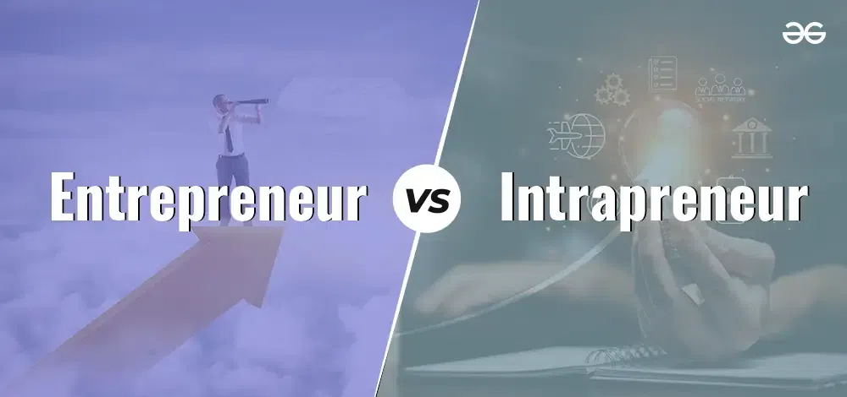

Slide 21
Basis | Entrepreneur | Intrapreneur
Meaning | An entrepreneur is an individual having a new and exclusive idea to establish something new. | Intrapreneur is an individual having entrepreneurial skills who works at a previously established company.
Motive | An entrepreneur's motive is to bring change to the world. | An intrapreneur's motive is to grow the business and make it better.
Nature | Entrepreneurs are innovative in nature. | Intrapreneurs are innovative in nature but less than entrepreneurs.
Risk Factor | Entrepreneurs are willing to take risks. | Intrapreneurs are willing to take risks but less than entrepreneurs.
Goals | Entrepreneurs focus on long-term profits. | Intrapreneur's goals are to get appraisals, appreciation, and promotions.
Competition | Entrepreneurs face low competition for their business. | Intrapreneur faces high competition in the market.
Position | Entrepreneurs are founders of a company. | Intrapreneurs are employees of a company.

Slide 22
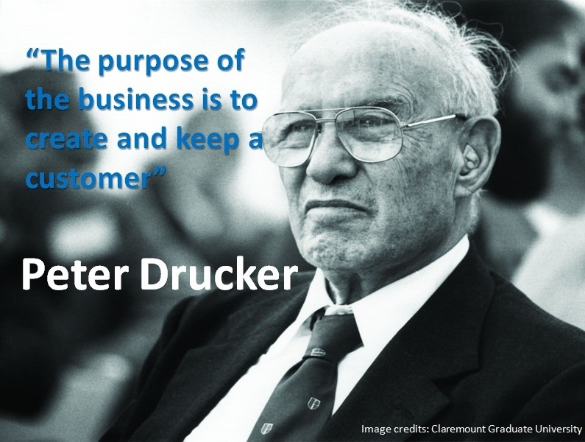

Slide 23
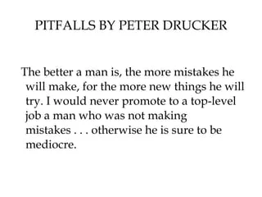

Slide 24
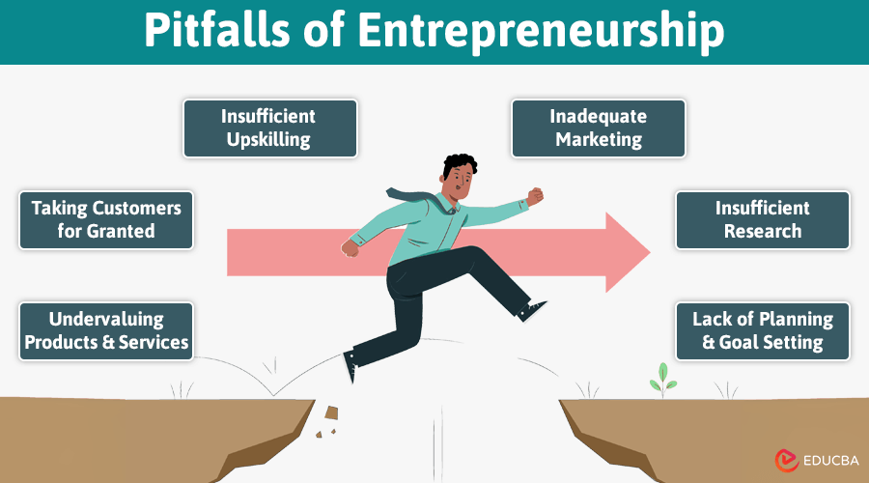

Slide 25
Entrepreneurial Failure and pitfalls (Peter Drucker)
Many businesses start out extremely well and then suddenly are up to their ears in trouble. Are there typical mistakes entrepreneurs make? Peter Drucker pointed out that there are four entrepreneurial pitfalls where the new and growing business typically gets into trouble.
Peter Drucker, a management guru, identified key pitfalls that entrepreneurs often face.
These include overlooking unexpected successes, neglecting cash flow management, struggling with rapid growth due to inadequate management, and prioritizing personal needs over business needs. Drucker also emphasized that entrepreneurs should continuously innovate and exploit opportunities arising from change.

Slide 26
Ignoring unexpected success:
Entrepreneurs may dismiss or fail to capitalize on unexpected positive outcomes in new markets.
Poor cash flow management:
Insufficient attention to cash flow can lead to financial crises, even for profitable businesses.
Management crisis due to rapid growth:
As businesses expand quickly, the existing management structure may become inadequate, leading to inefficiencies and bottlenecks.
Prioritizing personal needs over business needs:
When a business becomes successful, the entrepreneur's focus may shift from the needs of the business to their own desires or needs, hindering further growth.

Slide 27
Ignoring unexpected success
Poor cash flow management:
Context: In 1975, a Kodak engineer, Steve Sasson, invented the first digital camera. It was a groundbreaking innovation, but Kodak’s leadership largely ignored it.
Why it was an unexpected success: Although the prototype was crude, it showed the potential for a new kind of photography—one that didn’t require film. Internally, some teams saw this as a huge opportunity.
What went wrong: Kodak’s leadership didn’t fully support or commercialize the technology, fearing it would cannibalize their core film business. They underestimated how fast digital photography would evolve and how much consumers would embrace it.
The consequence: Other companies, like Sony and Canon, took the lead in digital photography. Kodak eventually filed for bankruptcy in 2012, despite having been in a position to lead the digital camera revolution.
Example of Poor Cash Flow Management: Toys “R” Us
Context: Toys “R” Us was once a global retail giant in the toy industry. However, despite having high sales, the company struggled with cash flow issues for years.
What went wrong:
High debt burden: After a leveraged buyout in 2005, the company was left with around $5 billion in debt.
Heavy interest payments: A significant portion of its cash flow went toward servicing debt, not reinvestment or operations.
Delayed vendor payments: The company often delayed payments to suppliers, leading to strained relationships and inventory issues.
Poor planning for seasonal demand: As a toy retailer, holiday seasons were crucial. But due to limited liquidity, the company often struggled to stock enough inventory on time.
The consequence: In 2017, Toys “R” Us filed for bankruptcy. Although the brand was strong, poor cash flow management—especially failing to balance inflows and outflows—was a major contributor to its downfall.

Slide 28
Management crisis due to rapid growth
Prioritizing personal needs over business needs:
Uber experienced explosive growth after its launch in 2009, expanding rapidly across cities and countries, disrupting the transportation industry.
What went wrong:
Lack of mature leadership systems: Rapid scaling outpaced the development of strong internal policies and leadership structure.
Toxic work culture: The company was criticized for having an aggressive, high-pressure environment. HR systems struggled to handle employee concerns effectively.
Regulatory clashes: Expansion happened so fast that the company often entered markets without proper legal clearance, leading to multiple legal and regulatory issues.
Leadership instability: Co-founder and CEO Travis Kalanick faced backlash over internal controversies, culminating in his resignation in 2017.
The consequence: Uber’s brand suffered, employee morale dropped, and investor confidence wavered. The company had to overhaul its culture, restructure leadership, and slow down expansion to stabilize.
Satyam Computers (India)
Context: Satyam Computers was one of India’s top IT firms, until a massive corporate fraud was uncovered in 2009, largely driven by the personal interests of its chairman, Ramalinga Raju.
What went wrong:
Conflict of interest: Raju tried to use Satyam’s funds to bail out his personally owned real estate ventures (Maytas Infra and Maytas Properties).
Diversion of resources: He proposed a $1.6 billion acquisition of these companies using Satyam’s funds—an action that had no strategic benefit for the business.
Falsification of accounts: To maintain the company’s stock price and image, he falsified financial statements and overstated assets and revenues for years.
The consequence: The fraud led to a total collapse in investor confidence, a sharp drop in share value, legal investigations, and Raju’s arrest. The company was eventually acquired by Tech Mahindra.

Slide 29
Contribution of Mc Cleland and Joseph Schumpeter
David McClelland and Joseph Schumpeter made distinct but valuable contributions to the understanding of entrepreneurship.
McClelland focused on the psychological traits of entrepreneurs, particularly the need for achievement, and its impact on economic development.
Schumpeter, on the other hand, emphasized the role of innovation and "creative destruction" in driving economic progress through entrepreneurship.

Slide 30
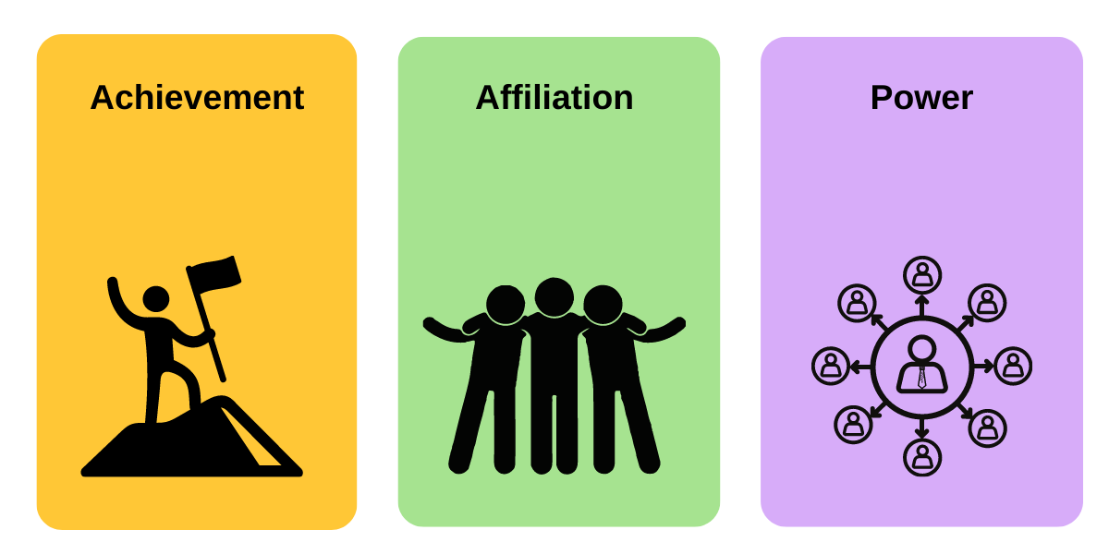

Slide 31
Need for Achievement Theory of McClelland:
McClelland's Need for Achievement Theory proposes that human behavior is influenced by three core needs: achievement, affiliation, and power. These needs are not innate but rather developed over time through cultural experiences and personal interactions. Understanding these needs can help in understanding individual motivations and managing teams effectively.
Key aspects of the theory:
Need for Achievement (n-Ach):
Individuals with a high need for achievement are driven to excel, meet challenging goals, and receive feedback on their performance. They prefer tasks with moderate risk and enjoy opportunities for personal accomplishment.
Need for Affiliation (n-Aff):
Individuals with a high need for affiliation seek harmonious relationships and enjoy working with others. They value teamwork and collaboration, and are motivated by social interaction and belonging.
Need for Power (n-Pow):
Individuals with a high need for power are driven to influence others and control their environment. They may seek leadership positions and enjoy competition.

Slide 32


Slide 33

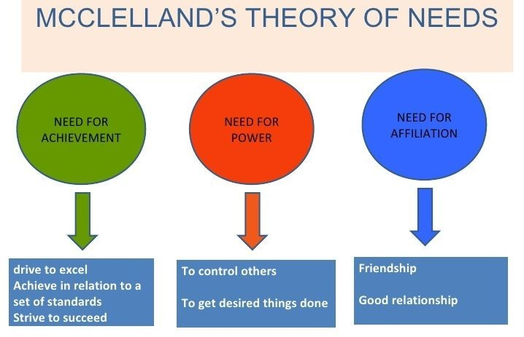

Slide 34
Innovation Theory of Schumpeter:
A dynamic theory of entrepreneurship was first advocated by Schumpeter (1949) who considered entrepreneurship as the catalyst that disrupts the stationary circular flow of the economy and thereby initiates and sustains the process of development. Embarking upon ‘new combinations’ of the factors of production - which he succinctly terms, innovation - the entrepreneur activates the economy to a new level of development.
Schumpeter defines entrepreneurship as “a creative activity”. An innovator who brings new products or services into economy is given the status of an entrepreneur. He regards innovation as a tool of entrepreneur, The entrepreneur is viewed as the ‘engine of growth’.
Schumpeter is the first major theorist to put the human agent at the centre of the process of economic development. He is very explicit about the economic function of the entrepreneur. The entrepreneur is the prime mover in economic development; his function, to innovate or carry out new combinations.

Slide 35
Point to note: Schumpeter differentiated between inventor & innovator
Schumpeter makes a distinction between an innovator and an inventor.
An inventor discovers new methods and new materials.
On the contrary, an innovator is one who utilizes or applies inventions and discoveries in order to make new combinations.
An inventor is concerned with his technical work of invention whereas an entrepreneur converts the technical work into economic performance.
An innovator is more than an inventor because he does not only originate as the inventor does but goes much farther in exploiting the invention commercially

Slide 36
The concept of innovation and its corollary development embraces five functions:
❖ The introduction of a new product with which consumers are not yet familiar or introduction of a new quality of an existing product,
❖ The introduction of new method of production that is not yet tested by experience in the branch of manufacture concerned, which need by no means be founded upon a discovery scientifically new and can also exist in a new way of handling a commodity commercially,
❖ The opening of new market that is a market on to which the particular branch of manufacturer of the country in question has not previously entered, whether or not this market has existed before,
❖ Conquest of a new source of supply of raw material and
❖ The carrying out of the new organisation of any industry.

Slide 37
1. Apple/Dyson Vacuum Cleaners - When Dyson launched its bagless vacuum cleaner in the 1990s, it introduced a new product with technology unfamiliar to most consumers—cyclonic separation.
2. Ford Assembly Line - In 1913, Henry Ford introduced the moving assembly line in automobile manufacturing at the Ford Motor Company. This was not a new scientific discovery, but a new method of production in the auto industry.
3. Starbucks entering the Chinese market - In 1999, Starbucks entered China, a country with a deep-rooted tea-drinking culture and very little exposure to Western-style coffee.
4. British East India Company and Indian Cotton (18th–19th Century) - During the 18th and 19th centuries, the British East India Company established control over vast regions of India, particularly targeting access to raw cotton, indigo, and spices.
5. Amazon’s Transformation of the Retail Industry - Amazon revolutionized the traditional retail industry by creating a new organizational model based on e-commerce, logistics, and data-driven personalization.

Slide 38
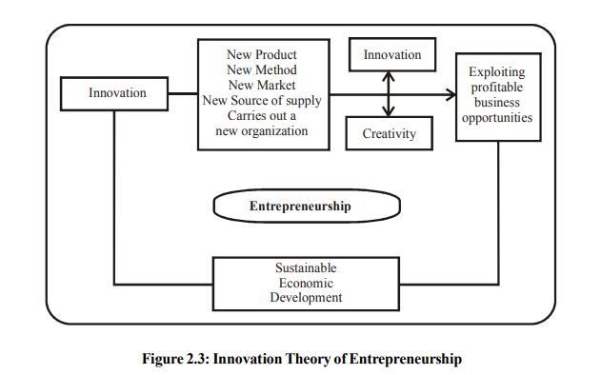

Slide 39
END OF UNIT 1

